Slide 1
HTML & HTML5
Web Programming

Slide 2
Why do we need HTML5?
Rich Web-based applications.
Generate better search results.
Better accessibility for people of all abilities.
Using different types of devices.

Slide 3
History of HTML
An unbroken line
Web pages from 1990 still render in modern browsers. Berners-Lee FAQ Examples
The ones that win are the ones that ship.
Most of the successful versions of HTML have been “retro-specs,” catching up to the world while simultaneously trying to nudge it in the right direction.
HTML 1.0, 2.0, 3.2, 4.0 -> HTML5

Slide 4
Why not XHTML 2?
1998: A transformation from HTML to XHTML
A new MIME type: application/xhtml+xml
XHTML 1.0 spec: http://www.w3.org/TR/xhtml1/#guidelines says that text/html can be used.
The line is broken:
New spec for creating forms: XHTML Extended Forms (Xforms) fail
Starting with version 1.1, all XHTML documents were to be served with a MIME type of application/xhtml+xml.
XHTML 2.0
Draconian error handling!

Slide 5
Back to basics
HTML: How to make good better?
WHAT Working Group (Web Hypertext Applications Technology Working Group)
Loose, unofficial, and open collaboration of Web browser manufacturers and interested parties.
In October 2006, Tim Berners-Lee announced that the W3C would work together with the WHAT WG to evolve HTML.
HTML5 – or just HTML (HTML – Living Standard)

Slide 6
… then what about XHTML?
HTML5 as well formed XML with the MIME type application/xhtml+xml:
XHTML5
OK, maybe not that important… – but in some cases useful.
Combining HTML with XML languages like RDF and SVG.

Slide 7
Polyglot Markup
…And just to complicate things.
HTML-Compatible XHTML Documents
Strict XML (XHTML) documents that can either be send with MIME type:
text/html
application/xhtml+xml

Slide 8
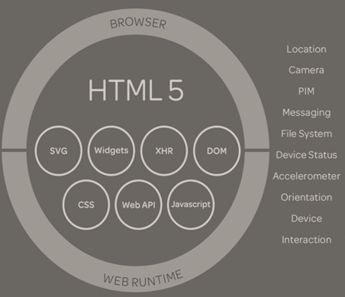
Whats included
New semantic elements
Forms – new input types
New attributes
New APIs
3D, Graphics and Effects
2D Canvas
WebGL
Storage
Persistent and session storage
Key/value
5mb+ (depends on browser)
IndexDb
SQL Storage
Connectivity
Device Access
GeoLocation
Accelerometer
Touch
Gyroscope
Multimedia
HTML5 Video
Web Workers / Web Sockets
XHR2

Slide 9
New semantic elements
New elements for structuring
section, article, aside, hgroup, header, footer, nav, figure
New elements for content
video, audio, track, embed, mark, progress, meter, time, ruby, bdi, wbr, canvas, command, details, datalist, keygen, output
… and a lot more for the input element.
Why?
Notes:
For us → semantics add to SEO
For mobile dev, input types matter. Numbers, dates, emails and so forth

Slide 10
<section>
The section element represents a generic section of a document or application. A section, in this context, is a thematic grouping of content, typically with a heading.
Authors are encouraged to use the article element instead of the section element when it would make sense to syndicate the contents of the element.
<article>
<hgroup>
<h1>Apples</h1>
<h2>Tasty, delicious fruit!</h2>
</hgroup>
<p>The apple is the pomaceous fruit of the apple tree.</p>
<section>
<h1>Red Delicious</h1>
<p>These bright red apples are the most common found in many supermarkets.</p>
</section>
<section>
…
</section>
</article>

Slide 11
<article>
The article element represents a self-contained composition in a document, page, application, or site and that is, in principle, independently distributable or reusable, e.g. in syndication.
E.g. a forum post, a magazine or newspaper article, a blog entry, a user-submitted comment, an interactive widget or gadget, or any other independent item of content.
<article>
<header>
<h1>The Very First Rule of Life</h1>
<p><time pubdate datetime="2009-10-09T14:28-08:00"></time></p>
</header>
<p>If there's a microphone anywhere near you, assume it's hot and
sending whatever you're saying to the world. Seriously.</p>
<p>...</p>
<footer>
<a href="?comments=1">Show comments...</a>
</footer>
</article>

Slide 12
<nav>
The nav element represents a section of a page that links to other pages or to parts within the page: a section with navigation links.
Not all groups of links on a page need to be in a nav element – the element is primarily intended for sections that consist of major navigation blocks.
<body>
<header>
<h1>Wake up sheeple!</h1>
<p><a href="news.html">News</a> - <a href="blog.html">Blog</a> - <a href="forums.html">Forums</a></p>
<p>Last Modified: <time>2009-04-01</time></p>
<nav>
<h1>Navigation</h1>
<ul>
<li><a href="articles.html">Index of all articles</a></li>
<li><a href="today.html">Today</a></li>
<li><a href="successes.html">Successes</a></li>
</ul>
</nav>
</header>
…

Slide 13
<aside>
The aside element represents a section of a page that consists of content that is tangentially related to the content around the aside element, and which could be considered separate from that content. Such sections are often represented as sidebars in printed typography.
The element can be used for typographical effects like pull quotes or sidebars, for advertising, for groups of nav elements, and for other content that is considered separate from the main content of the page.
<body>
<header>
<h1>My wonderful blog</h1>
<p>My tagline</p>
</header>
<aside>
<!-- this aside contains two sections that are tangentially related to the page, namely, links to other blogs, and links to blog posts from this blog -->
<nav>
<h1>My blogroll</h1>
<ul>
<li><a href="http://blog.example.com/">Example Blog</a>
</ul>
</nav>
<nav>
<h1>Archives</h1>
<ol reversed>
<li><a href="/last-post">My last post</a>
<li><a href="/first-post">My first post</a>
</ol>
</nav>
</aside>

Slide 14
<header>
The header element represents a group of introductory or navigational aids.
<body>
<header>
<h1>Little Green Guys With Guns</h1>
<nav>
<ul>
<li><a href="/games">Games</a>
<li><a href="/forum">Forum</a>
<li><a href="/download">Download</a>
</ul>
</nav>
<h2>Important News</h2>
…

Slide 15
<footer>
The footer element represents a footer for its nearest ancestor sectioning content or sectioning root element. A footer typically contains information about its section such as who wrote it, links to related documents, copyright data, and the like.
…
<footer> <!-- footer for article -->
<p>Published <time pubdate datetime="2009-09-15T14:54-07:00"></time></p>
</footer>
</article>
<footer> <!-- site wide footer -->
<nav>
<p><a href="/credits.html">Credits</a> — <a href="/tos.html">Terms of Service</a> — <a href="/index.html">Blog Index</a></p>
</nav>
<p>Copyright © 2014</p>
</footer>
</body>
</html>

Slide 16
<hgroup>
The hgroup element represents the heading of a section. The element is used to group a set of h1–h6 elements when the heading has multiple levels, such as subheadings, alternative titles, or taglines.
The point of using hgroup in this example is to mask the h2 element (which acts as a secondary title) from the outline algorithm.
<hgroup>
<h1>The reality dysfunction</h1>
<h2>Space is not the only void</h2>
</hgroup>

Slide 17
<figure>
The figure element represents some flow content, optionally with a caption, that is self-contained and is typically referenced as a single unit from the main flow of the document.
<figure>
<img src="bubbles-work.jpeg" alt="Bubbles, sitting in his office chair, works on his latest project intently.">
<figcaption>Bubbles at work</figcaption>
</figure>

Slide 18
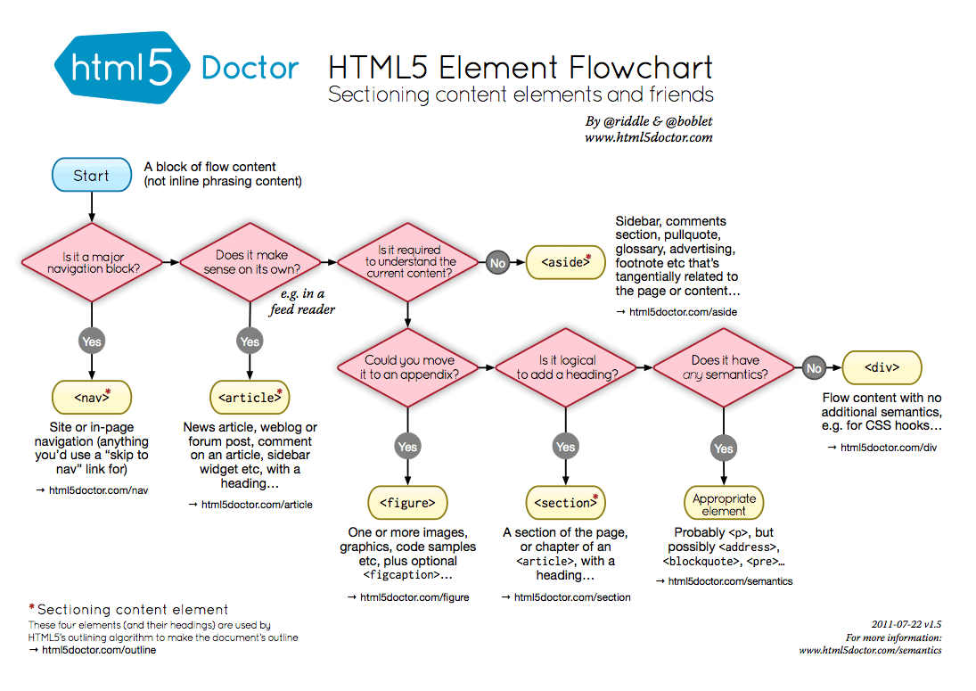

Slide 19
Forms – new input types and elements
New input types
Form validation
New elements
Datalists
Output
http://www.bradshawenterprises.com/tests/formdemo.php

Slide 20
Forms – Input types
Keyword | Data type | Control type
hidden | An arbitrary string | n/a
text | Text with no line breaks | Text field
search | Text with no line breaks | Search field
tel | Text with no line breaks | A text field
url | An absolute IRI | A text field
email | An e-mail address or list of e-mail addresses | A text field
password | Text with no line breaks (sensitive information) | Text field that obscures data entry
datetime | A date and time (year, month, day, hour, minute, second, fraction of a second) with the time zone set to UTC | A date and time control
date | A date (year, month, day) with no time zone | A date control
month | A date consisting of a year and a month with no time zone | A month control
week | A date consisting of a week-year number and a week number with no time zone | A week control
time | A time (hour, minute, seconds, fractional seconds) with no time zone | A time control
datetime-local | A date and time (year, month, day, hour, minute, second, fraction of a second) with no time zone | A date and time control
number | A numerical value | A text field or spinner control
range | A numerical value, with the extra semantic that the exact value is not important | A slider control or similar
color | An sRGB color with 8-bit red, green, and blue components | A color well
checkbox | A set of zero or more values from a predefined list | A checkbox
radio | An enumerated value | A radio button
file | Zero or more files each with a MIME type and optionally a file name | A label and a button
submit | An enumerated value, with the extra semantic that it must be the last value selected and initiates form submission | A button
image | A coordinate, relative to a particular image's size, with the extra semantic that it must be the last value selected and initiates form submission | Either a clickable image, or a button
reset | n/a | A button
button | n/a | A button

Slide 21
Form validation
Depend on the type
Validating on a predefined pattern or value
The pattern can be controlled by the attribute pattern
Other attributes:
min, max, maxlength
<form method="post" action="formdemo.php">
<label for="name">Name:</label>
<input type="text" placeholder="Name" required="" name="name">
<label for="email">Email:</label>
<input type="email" placeholder="email@example.com" required="" name="email">
<label for="website">Website:</label>
<input type="url" placeholder="http://www.example.com" required="" name="website">
<label for="number">Number:</label>
<input type="number" placeholder="Even num &lt; 10" required="" step="2" max="10" min="0“ name="number">
<label for="range">Range:</label>
<input type="range" step="2" max="10" min="0" name="range">
<label for="message">Message:</label>
<textarea required="" name="message"></textarea>
<input type="submit" value="Send Message">
</form>
Notes:
This works without JS
Note that the validation design cannot be overridden.

Slide 22
Form – Datalist element
The datalist element represents a set of option elements that represent predefined options for other controls.
<input type="url" list="url_list" name="link" />
<datalist id="url_list">
<option label="W3Schools" value="http://www.w3schools.com" />
<option label="Google" value="http://www.google.com" />
<option label="Microsoft" value="http://www.microsoft.com" />
</datalist>
Notes:
Datalist is thought as a suggestion
Select is a ”you have to select one”

Slide 23
Forms – Output element
The output element is used for different types of output, like calculations.
<form oninput="x.value=parseInt(a.value)+parseInt(b.value)">
<input type="range" name="a" value="50" />
+<input type="number" name="b" value="50" />
=<output name="x" for="a b"></output>
</form>

Slide 24
New attributes
Attribute | Value | Description
contenteditable | true false inherit | Specifies whether a user can edit the content of an element or not
contextmenu | menu_id | Specifies a context menu for an element. The value must be the id of a <menu> element
draggable | true false auto | Specifies whether a user is allowed to drag an element or not
dropzone | copy move link | Specifies what happens when dragged items/data is dropped in the element
hidden | hidden | Specifies that an element should be hidden
spellcheck | true false | Specifies if the element must have its spelling and grammar checked
data-* | value | Custom data attributes are intended to store custom data private to the page or application.

Slide 25
data-* attribute
A custom data attribute is an attribute in no namespace whose name starts with the string "data-", has at least one character after the hyphen.
XML-compatible
Custom data attributes are intended to store custom data private to the page or application, for which there are no more appropriate attributes or elements.
<ol>
<li data-length="2m11s">Beyond The Sea</li>
...
</ol>

Slide 26
Exercises
Basic HTML pages
Create a small website containing 3 pages that link to each other. You can start from scratch or you can copy the file basicpage.html.
Create a web page or copy basicpage.html
At some point copy the web page and link them together. The links can be part of a menu on the pages.
More HTML elements
From the above exercise extend the web pages with more elements like:
Lists
A table
An image
Semantic elements
For inspiration look at http://docs.webplatform.org/wiki/html/tutorials or http://www.w3schools.com/html/.
Redo web page
A web page is not just a web page. Redo the HTML markup for the web page http://www.bates-cargopak.com/default.aspx. As a starting point the page should not be styled (CSS). I expect a web page that:
validates according to a defined doctype
has a logical content flow. Look at the order in witch the content is ordered
requires a minimum of HTML markup. Look at the file size
is flexible, fitting in both a mobile phone and a desktop computer
It's up to you if you will a semantic HTML elements to the page.
Notes:
https://validator.w3.org/

